Slide 1


Chapter Ten
Wage Structures Across Markets
Prepared by Dr. Mir Ahasan Kabir
York University

Slide 2
Learning Objectives
Discuss how the Roy model provides a more general approach to wage setting when different workers have different levels of skills and productive abilities.
Explain the several factors that account for the wage differences across labour markets, including supply and demand factors and other explanations, such as compensating wages differences, institutional rigidities, and short-run disequilibrium.
Discuss the large differences in wages paid to different workers depending on the kind of job they hold (industry and occupation) and where they work (region and size of the firm).
Explain how interindustry wage differentials may be generated by “efficiency wages,” whereby firms pay higher wages because worker productivity depends on the wage rate.
Learn that the public sector is one particularly large industry (over one-fifth of employment in Canada) that pays higher wages and other forms of compensation than do other industries.
© 2021 MCGRAW-HILL EDUCATION LTD.
10 - <number>

Slide 3
Main Questions
Why might wages vary across labour markets, even among apparently identical workers?
Are public sector workers overpaid? Why are wages higher in Alberta than in Ontario?
What are the main determinants of the decision to migrate from one province to another?
Large firms pay higher wages to workers than do small firms. Can this be taken as evidence against the neoclassical supply and demand model of the labour market?
Which industries and occupations provide the highest wages for their workers?
Can these higher wages be accounted for by differences in the skills of the workers?
© 2021 MCGRAW-HILL EDUCATION LTD.
10 - <number>

Slide 4
Explorations with the 2016 Census
Individual (log) wages depend on:
  Formal schooling
  Labour market work experience
  Unobserved ability or luck
  Other characteristics
Ln Y_{i}= α + rS + β1EXP + β2EXP² + γX_{i} + ε_{i}
Where:
Y = Earning; α = Fixed component of wage with no schooling; r = i = internal rate of return; S = Years of schooling; EXP = Experience (Age as a proxy); ε = unobserved ability or luck
Coefficients on schooling (r), experience (β), and other characteristics (γ) can be interpreted as their rates of return
© 2021 MCGRAW-HILL EDUCATION LTD.
10 - <number>

Slide 5
Explorations with the 2016 Census
Pure regional wage differential
Occupational premiums
Industry premiums
© 2021 MCGRAW-HILL EDUCATION LTD.
10 - <number>

Slide 6
Explorations with the 2016 Census
Table 10.1 Earnings Differentials by Province, Occupation, and Industry, Canada, 2015
Province | % Jobs | Premium
Newfoundland and Labrador | 1.3 | 4.1
Prince Edward Island | 0.3 | −12.8
Nova Scotia | 2.7 | −8.1
New Brunswick | 2.1 | −11.1
Quebec | 22.8 | −11.5
Ontario | 39.9 | —
Manitoba | 3.5 | −2.6
Saskatchewan | 2.8 | 10.1
Alberta | 13.1 | 18.1
British Columbia | 12.1 | 1.6
© 2021 MCGRAW-HILL EDUCATION LTD.
10 - <number>

Slide 7
Explorations with the 2016 Census
Table 10.1 Earnings Differentials by Province, Occupation, and Industry, Canada, 2015
Occupation |  |  | Industry
 | % Jobs | Premium |  | % Jobs | Premium
Senior management | 2.0 | 56.1 | Agriculture, forestry, and fishing | 1.5 | −35.1
Middle management | 5.0 | 28.5 | Other primary | 2.4 | 51.3
Other management | 9.1 | 9.5 | Utilities | 1.5 | 38.5
Professionals (business and finance) | 3.4 | 14.8 | Construction | 10.2 | −4.2
Finance and administration | 5.8 | −15.6 | Manufacturing | 16.2 | —
Clerical | 1.1 | −25.6 | Wholesale trade | 6.4 | 1.7
Professionals (science) | 8.0 | 14.2 | Retail trade | 9.6 | −23.6
Other science occupations | 5.8 | −2.1 | Transportation and warehousing | 7.1 | −0.7
Professionals (health) | 1.0 | 30.9 | Information and culture | 2.9 | 5.4
Other health occupations | 1.0 | 0.9 | Finance and insurance | 4.5 | 16.2
Professionals (education and social services) | 4.8 | 10.4 | Real estate and leasing | 1.3 | −8.9
Other education and social occupations | 3.0 | 10.0 | Professional services | 7.9 | −3.1
Professionals (arts, culture, and recreation) | 1.4 | −21.3 | Administrative and support, and waste management | 3.5 | −25.7
Sales and service supervisors | 4.4 | −9.5
Sales representatives | 5.7 | −18.7 | Educational services | 4.5 | −16.4
Sales and services support | 4.2 | −33.4 | Health and social assistance | 3.5 | −22.8
Trade workers | 15.3 | — | Accommodation and food | 3.6 | −57.6
Transportation and trade helpers | 10.1 | −22.7 | Other services (except public administration) | 4.6 | −27.8
Supervisors and technicians (primary and secondary sectors) | 5.8 | −8.2 | Public administration | 8.8 | 6.8
Labourers | 3.3 | −30.4
© 2021 MCGRAW-HILL EDUCATION LTD.
10 - <number>

Slide 8
Theoretical Issues
Compensating differentials
Immobility across sectors
Short run vs. long run
Unobserved heterogeneity
© 2021 MCGRAW-HILL EDUCATION LTD.
10 - <number>

Slide 9
Occupational Wage Structures
The wage structure between various occupations or occupation groups:
  National Occupational Classification (NOC)
    Occupation (definition)
  26 two-digit major groups
  17 occupational classifications
  520 four-digit codes (in the 2001 NOC)
© 2021 MCGRAW-HILL EDUCATION LTD.
10 - <number>

Slide 10
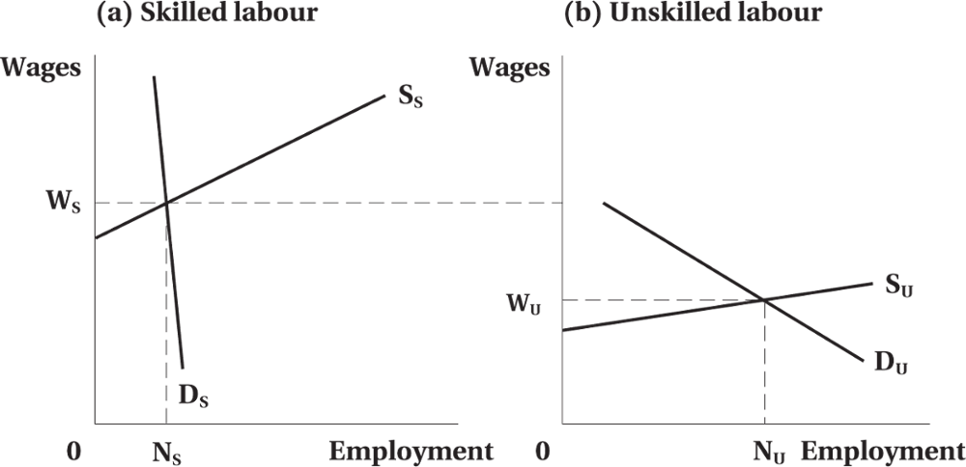
Occupational Wage Structures
Figure 10.1 Occupational Wage Differentials
© 2021 MCGRAW-HILL EDUCATION LTD.
10 - <number>

Slide 11
Reasons for Interoccupational Wage Differentials
Compensation for:
  Nonpecuniary differences
  Human capital investment
  Endowed skills
Short-run adjustments:
  Demand factors
Noncompetitive factors:
  Occupational licensing, regulation on entry, unions and legislation on wages
© 2021 MCGRAW-HILL EDUCATION LTD.
10 - <number>

Slide 12
Heterogeneous Workers and the Roy Model
Finding a competitive equilibrium when different workers earn different wages in different occupations is challenging.
The Roy Model
  Individuals are believed to be endowed with skills that are valued in the marketplace, in which case the wage premium that is paid to them reflects their natural embodiment of these skills.
© 2021 MCGRAW-HILL EDUCATION LTD.
10 - <number>

Slide 13
Regional Wage Structures and Geographic Mobility
Reasons:
  Geographic preferences
  Compensating differences
    cost of living, remoteness, climate, non-price externalities, pollution, congestion
  Short-run factors
    induce mobility to encourage long run equilibrium
  Noncompetitive factors
    cost of moving, artificial barriers and public policies (e.g., occupational licensing)
Social Transfer and Regional Expansion Programs
© 2021 MCGRAW-HILL EDUCATION LTD.
10 - <number>

Slide 14
Regional Wage Structures and Geographic Mobility
Migration Decision
Geographic mobility will occur if marginal benefit exceeds marginal costs
Factors influencing mobility:
  Age
  Unemployment rates
  Business cycle
  Distance
  Cultural differences
© 2021 MCGRAW-HILL EDUCATION LTD.
10 - <number>

Slide 15
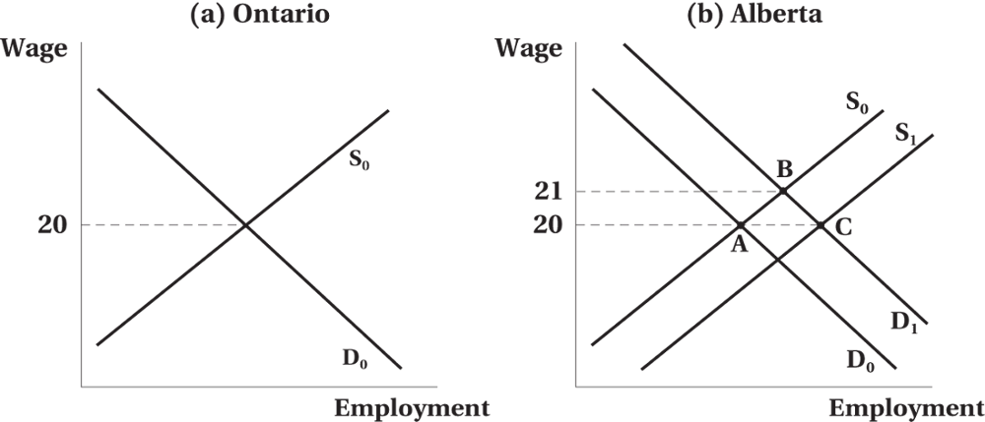
Regional Wage Structures and Geographic Mobility
Effect of an Oil Shock on Regional Wages
© 2021 MCGRAW-HILL EDUCATION LTD.
10 - <number>

Slide 16
Interindustry Wage Differentials
Theoretical Determinants of Interindustry Wage Differentials
  Average industry wage reflects a variety of factors:
    Occupational composition
    Personal characteristics
    Regional domination
  Pure industry wage differentials are difficult to calculate
© 2021 MCGRAW-HILL EDUCATION LTD.
10 - <number>

Slide 17
Interindustry Wage Differentials
Nonpecuniary aspects:
  unpleasant or unsafe work conditions, seasonal or cyclical employment
Short-run demand factors:
  reallocation, technology change, free trade, and global competition
Noncompetitive factors:
  monopoly rents, wage laws, unions, and licensing
© 2021 MCGRAW-HILL EDUCATION LTD.
10 - <number>

Slide 18
Interindustry Wage Differentials
Efficiency Wages, “Good Jobs,” and Interindustry Wage Differences
Firms may pay wages above market rate to:
  Improve morale
  Reduce turnover
  Elicit effort
  Discourage unionization
  Establish queue of applicants
© 2021 MCGRAW-HILL EDUCATION LTD.
10 - <number>

Slide 19
Interindustry Wage Differentials
Efficiency Wages, “Good Jobs,” and Interindustry Wage Differences
Productivity-enhancing wages
Payment of efficiency wages may differ by industry
Voluntarily paid by the firm
Rationale for policies designed to protect “good jobs”
© 2021 MCGRAW-HILL EDUCATION LTD.
10 - <number>

Slide 20
Interindustry Wage Differentials
Empirical Evidence on Interindustry Wage Differences, Efficiency Wages, and the Impact of Deregulation
The interindustry wage structure tends to be quite stable over time and across different countries.
Industries that are subject to greater competitive pressures on the product market (e.g., import competition, deregulation, more competing firms) tend to pay lower wages.
The evidence also suggests the existence and persistence of pure interindustry wage differentials or rents that are consistent with the payment of efficiency wages.
© 2021 MCGRAW-HILL EDUCATION LTD.
10 - <number>

Slide 21
Interfirm Wage Differences and Firm Size
Nonpecuniary factors:
  Poor working conditions
Short-run demand changes
Noncompetitive conditions:
  Monopoly position in the product market
  Union in the labour market
  Efficiency wages
© 2021 MCGRAW-HILL EDUCATION LTD.
10 - <number>

Slide 22
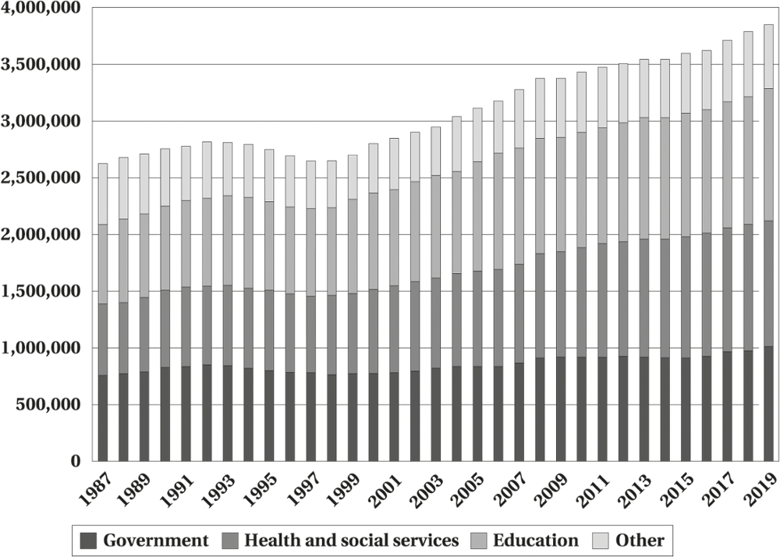
Public–Private Sector Wage Differentials
Figure 10.2 Public Sector Employment, Canada, 1987–2019
© 2021 MCGRAW-HILL EDUCATION LTD.
10 - <number>

Slide 23
Public–Private Sector Wage Differentials
Nonpecuniary factors:
  job security, fringe benefits, and political visibility
Short-run factors:
  reflect a short run disequilibrium
Noncompetitive factors:
  political constraint, monopsony, inelastic demand, and unionization
© 2021 MCGRAW-HILL EDUCATION LTD.
10 - <number>

Slide 24
Chapter Summary
Different dimensions of earnings differentials
  Occupation, region, industry, and public vs. private sector
Sectors wage differentials and labour mobility
Efficiency wages
Theoretical determinants of public vs. private wage differentials
© 2021 MCGRAW-HILL EDUCATION LTD.
10 - <number>

